Slide 1
SPARK -
Team Members:
Mouriya Madhavan S.B
Mohammed Arshath J
Om Prakash M
Gokul Kannan G
Prashaanth S
Devanath V
Poornima R
PROJECT : YellowPages “The retro Phonebook”

Slide 2
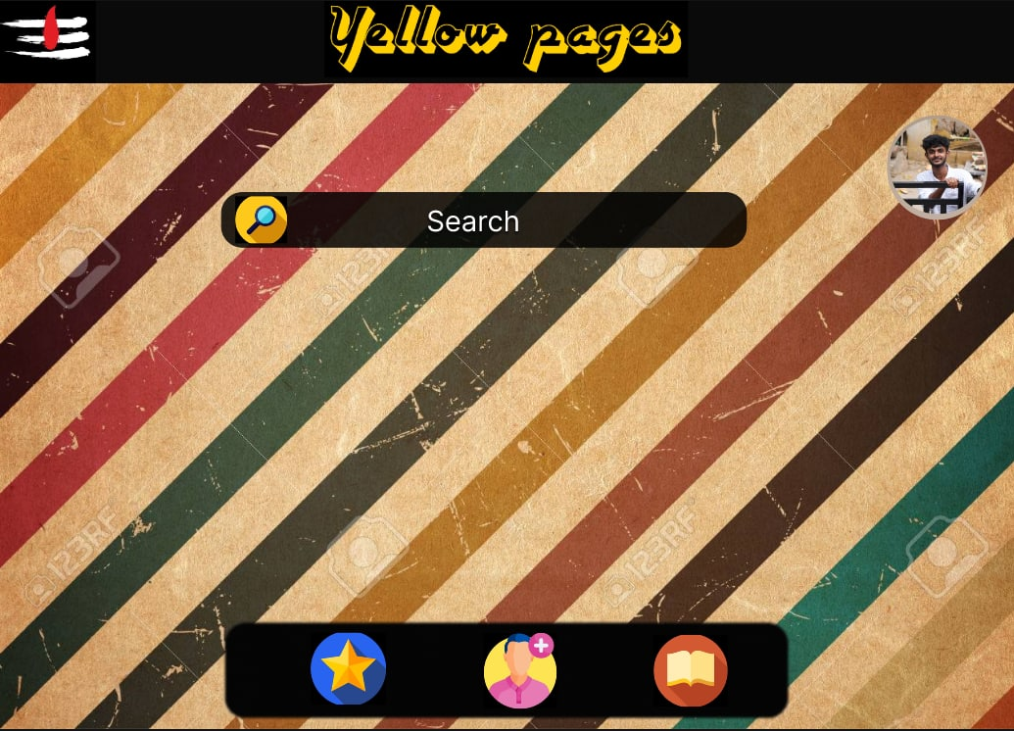

Slide 3
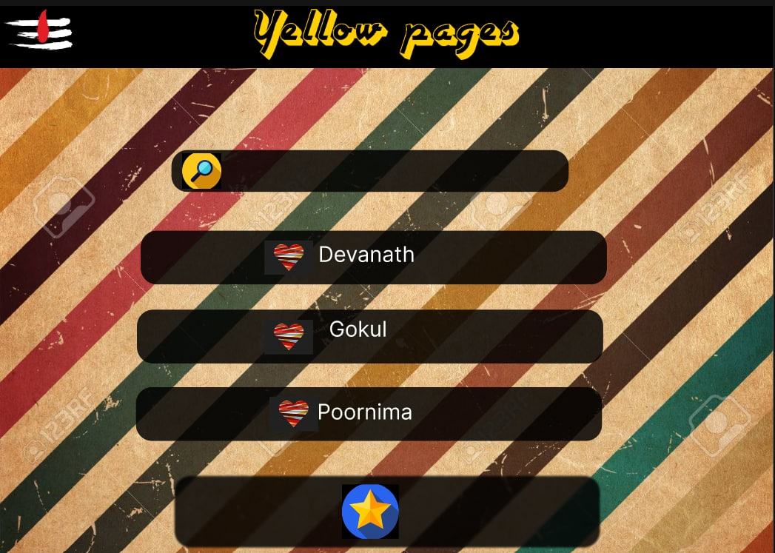

Slide 4
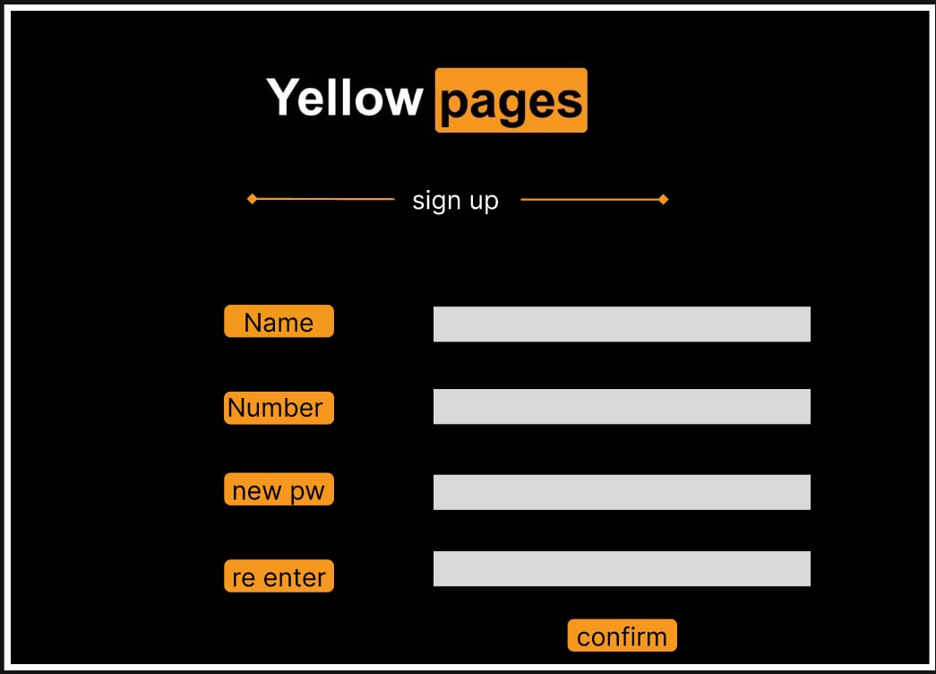

Slide 5
Links :
Figma ; https://www.figma.com/file/I6PpTb01p6BFzFQLAfQizC/Yellow-Pages?node-id=0%3A1
https://github.com/omprakaxh

Slide 6
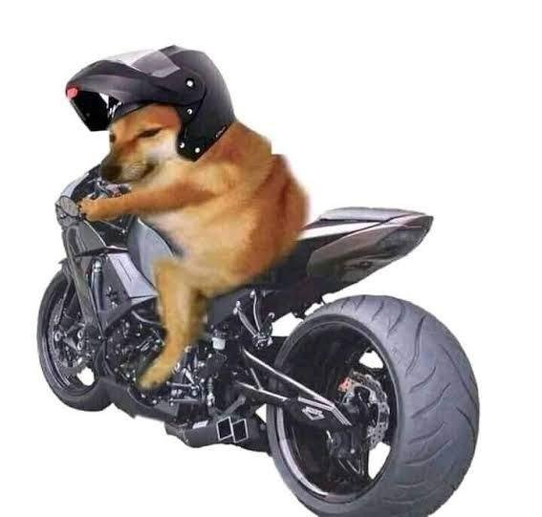
THANK YOU
WE will be back
With another project…
THANK YOU

